Slide 1

Python Data Science, AI, ML
Impact of ADHD and Mental Health Symptoms on Academic Outcomes in South African University Students: An ML Approach

Slide 2
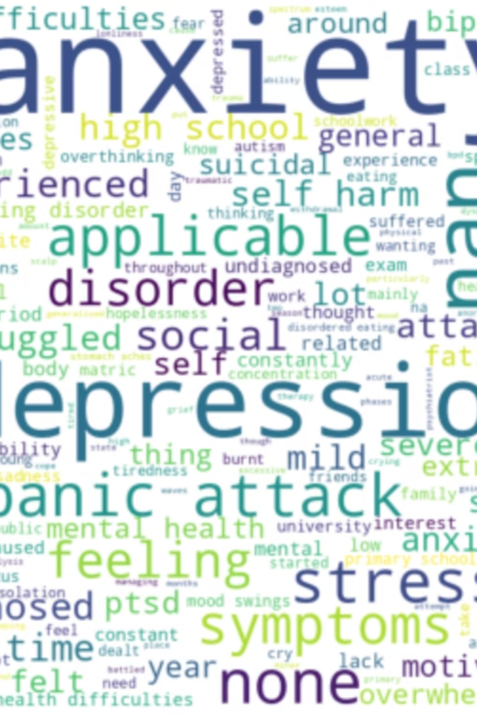
Discover the dataset and mission
This research uses machine learning to identify relationships between ADHD, mental health, and academic performance in South African university students. The goal is to predict if a student has ADHD or related conditions, diagnosed or not.

Slide 3






Project Pipeline: From Raw Data to Deployment
Data Cleaning & Understanding
Handle missing values, encode categories, engineer ADHD target
Visualization & EDA
Explore score distributions, build correlations, spot risk clusters.
Model Building & Selection
Best model; tune hyper-parameters; pick best performer.
Deployment (Web App)
Pickle model, integrate Flask UI for real-time predictions.
Results • Insights • Conclusion
Evaluate metrics, interpret findings, outline next steps.

Slide 4

Dataset Structure
Demographics: Age, Sex, Home LanguageMental Health History: Diagnosis, Medication, Therapy (past & current)Academic Performance: GPA, Matric marks, NBT scores
Psychological Assessments:
ASRS: ADHD symptoms
BDI: Depression
BAI: Anxiety
AUDIT: Alcohol use
AAS: Suicidality / Affect

Slide 5
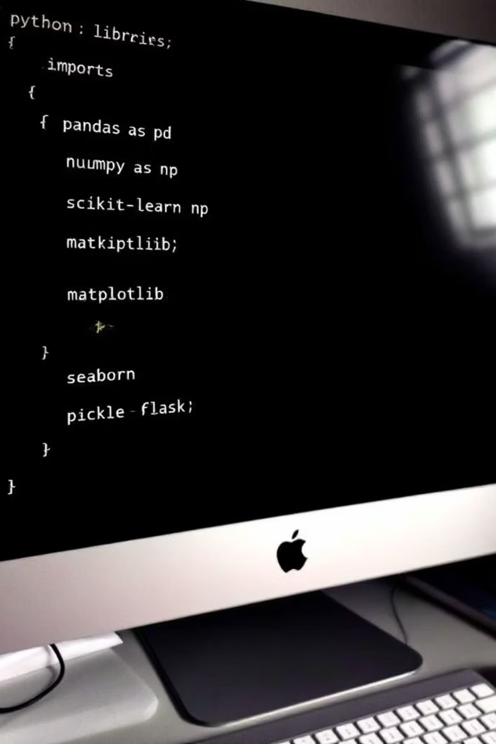
Libraries Used
import pandas as pdimport numpy as npfrom sklearn.model_selection import train_test_split, GridSearchCVfrom sklearn.ensemble import RandomForestClassifierfrom sklearn.linear_model import LogisticRegressionfrom sklearn.metrics import classification_report, confusion_matriximport matplotlib.pyplot as pltimport seaborn as snsimport picklefrom flask import Flask

Slide 6
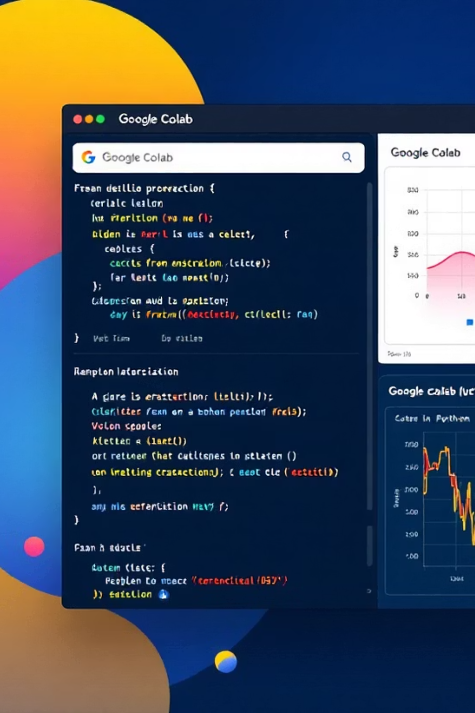
Data Cleaning
Rename and Drop Columns
Missing and incosistent data
Use rename()+ drop()to improve readability and remove noise
Make data usable by filling in or removing gaps
health_full.rename(columns={''}, inplace=True)
health['symptom_list'] = health['symptom_list'].fillna('No')
Target variables
Label Encoding
Add target columns through methods and fuctions
Convert text categories into numbers for machine learning
def adhd(row): return health['ADHD'] = ( (health['v1'] >= ) |(health['v2'] >=)).astype(int)
le= preprocessing. LabelEncoder()health["diagnosed"]=le.fit_transform(health["diagnosed"])

Slide 7
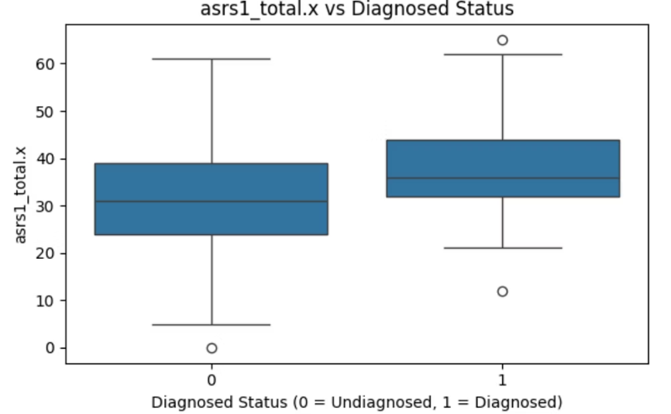
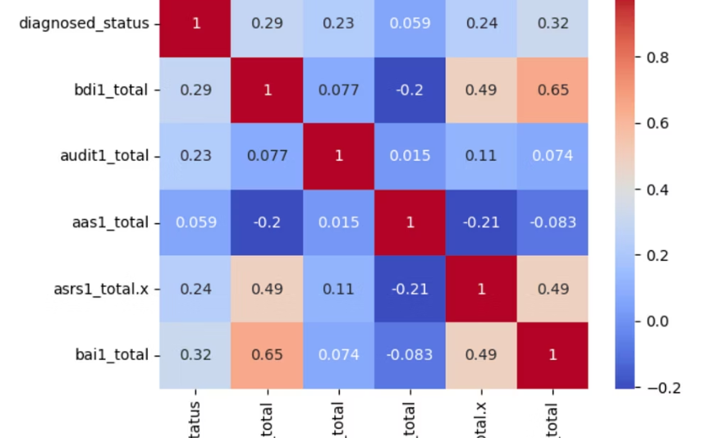
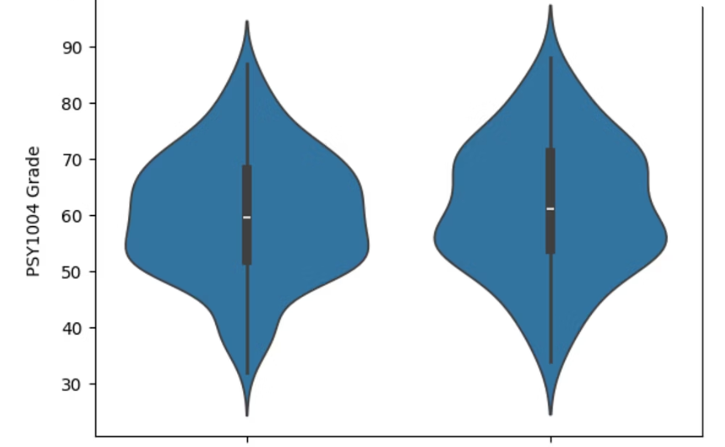
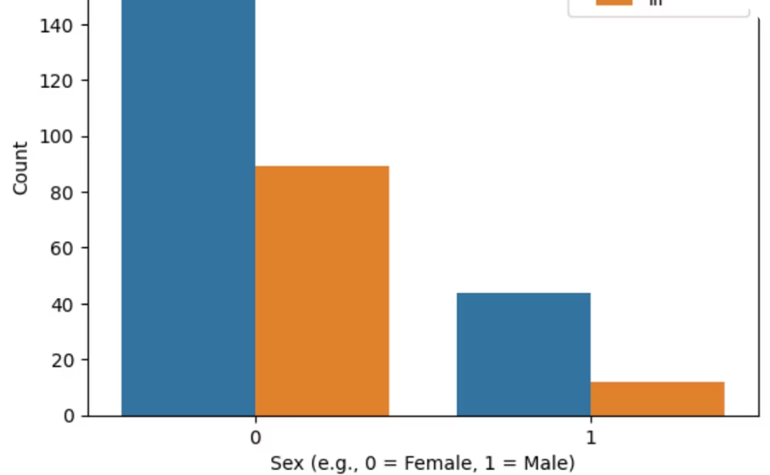
Visualisation
Types of graphs
Data Types
Boxplot
Shows the distribution, central tendency, and variability, highlighting outliers and comparing groups.
Heatmap
Visualises the correlation between variables, using colour gradients.
Box plot
Heatmap
Score distribution comparison
Variable relationship strength
Violinplot
show the full distribution and density of grades across diagnosed groups, highlighting central tendency and spread.
Count plot
display the frequency of diagnosed vs. healthy individuals within each gender group.
Violin plot
Count Plot
Grade distribution comparison
Diagnosis by gender

Slide 8

Model Training & Evaluation Workflow
Define Target and Features
1
set the variable to predict
y=health['Target']x=health.drop(columns=['diagnosed'])
2
Train-Test Split
Split the data while keeping label proportions balanced for fair evaluation.
Choose & Train Models
x_train, x_test, y_train, y_test = train_test_split(x, y, stratify=y, random_state=42)
Call the model type and fit it on the training data
tree_model = DecisionTreeClassifier() tree_model.fit(x_train, y_train)
4
Predict on Test Data
Generate predictions using the trained model
5
y_pred = SVM_model.predict(x_test_scaled)
Evaluate Model Performance
Check model accuracy
accuracy = accuracy_score(y_test, y_pred)

Slide 9


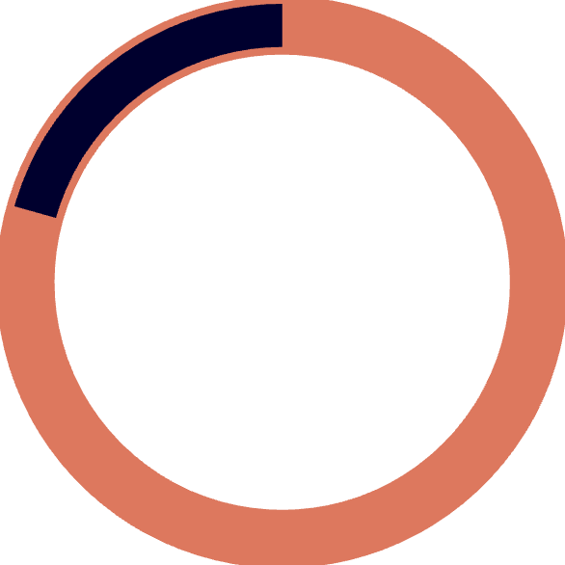

Model Selection
96.2%
89.8%
79.4%
62.1%
SVM
Logistic Regression
Decision tree
OLS Regression
Works well by finding the best boundary to separate groups, so it diagnoses yes or no accurately.
For classification, predicts probabilities clearly, so it fits binary outcomes like ADHD status accurately
Can capture some non-linear patterns but overfits or misses subtle details, leading to lower accuracy.
Meant for continuous predictions, not categories, so it struggles to classify ADHD status precisely

Slide 10
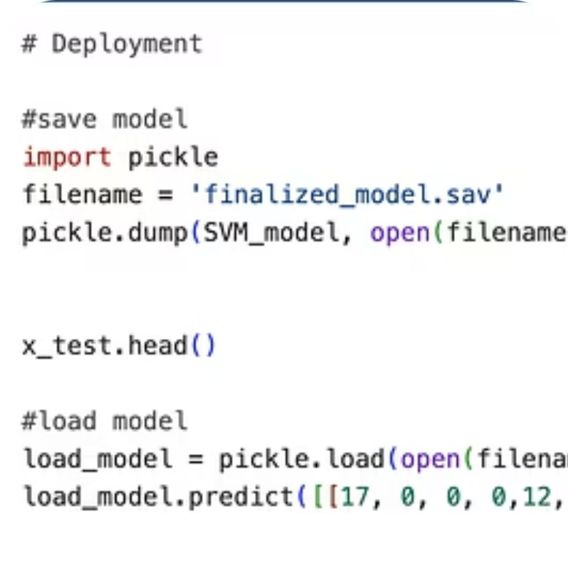
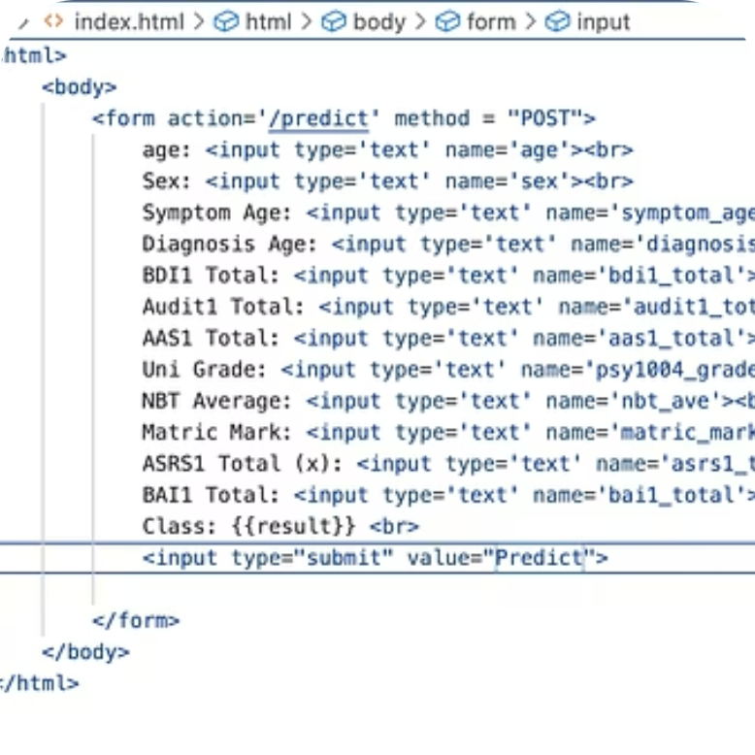
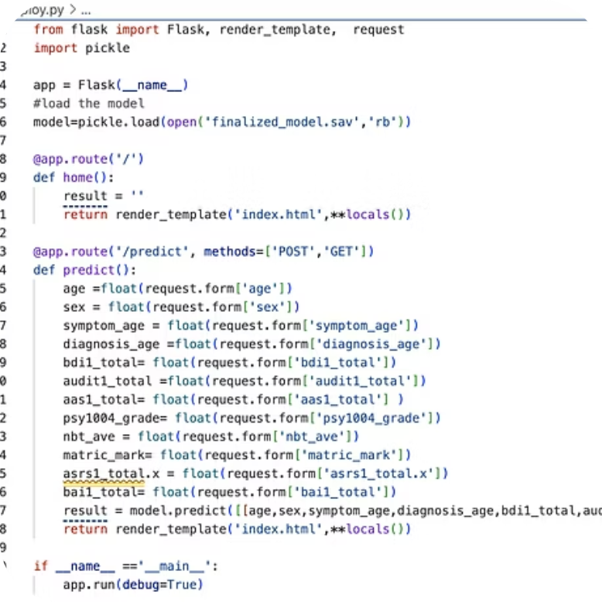
Model Deployment Workflow
Save & Load the Final Model
Backend Integration
Frontend Interface
After selecting the best model , we save it using pickle and reload it later for predictions
A Python backend (deploy.py) is created to handle model input/output using the Flask framework.
An HTML file (index.html) is built to take user input and display the prediction result on a web page.

Slide 11

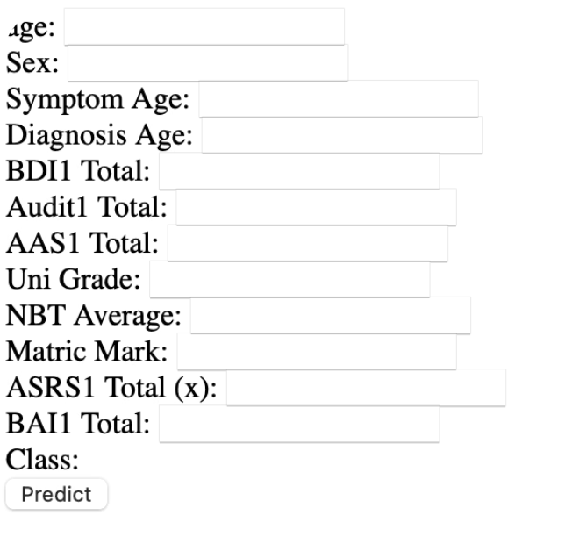
Deployment : Web APP

Slide 12
Insights
1
SVM Performed Best
2
Gender Differences Observed
3
Depression & Anxiety Are Central Factors
Achieved highest accuracy (92%) and is ideal for future use.
Countplot shows higher diagnosis rates vary by sex.
Heatmap shows they strongly influence other health indicators.
4
OLS Is Not Ideal for Classification
Despite explaining 64% of variance (R² = 0.64), its predictive performance was poor due to regression limitations.

Slide 13
Improvements
1
Use SVM for Deployment
2
Enhance the Web App
3
Add More Data Features
Reliable performance makes it suitable as the main predictive model.
Improve UI and store inputs to offer insights beyond “healthy/ill”.
Include social and lifestyle variables to improve prediction quality.
4
Test on Broader Populations
Validate model on diverse student groups for better generalization.

Slide 14
Thank You

